Slide 1
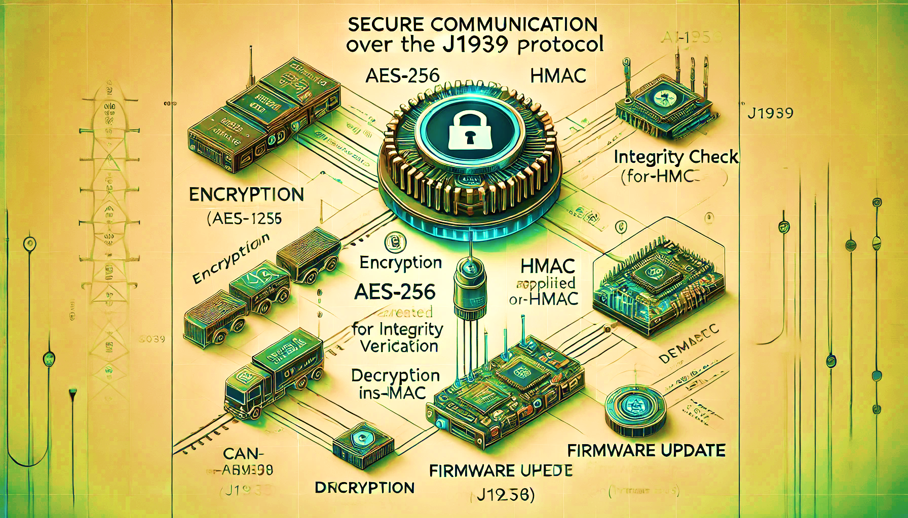
AI Generated
J1939 Secure Communications
SockBurst

Slide 2
Topics to be covered :

Slide 3
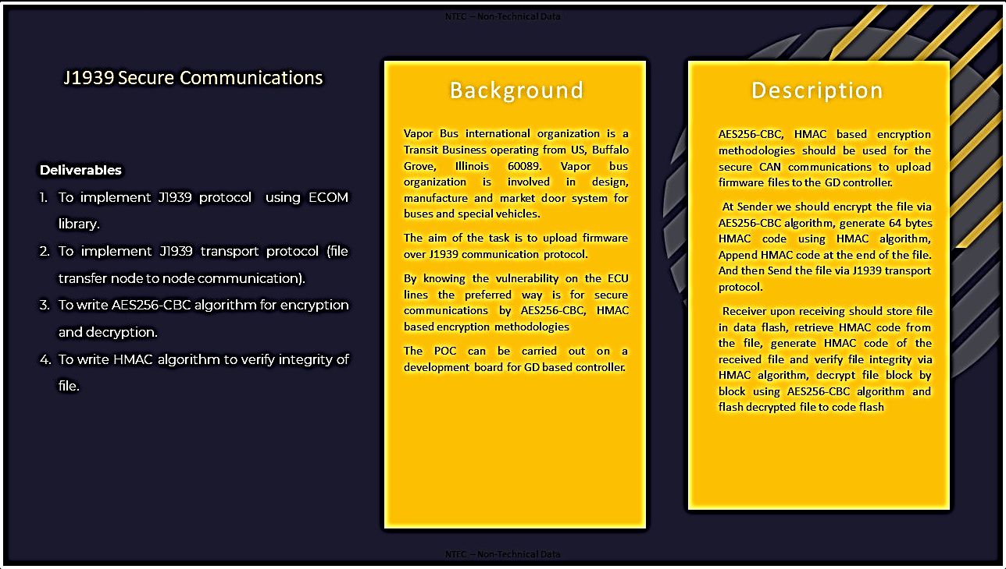
Slide 2 of N

Slide 4

Our design implementation and Approach.
Slide 3 of N

Slide 5

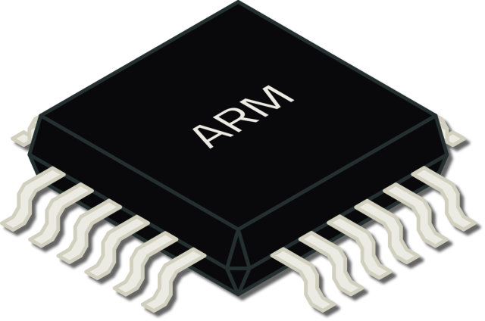

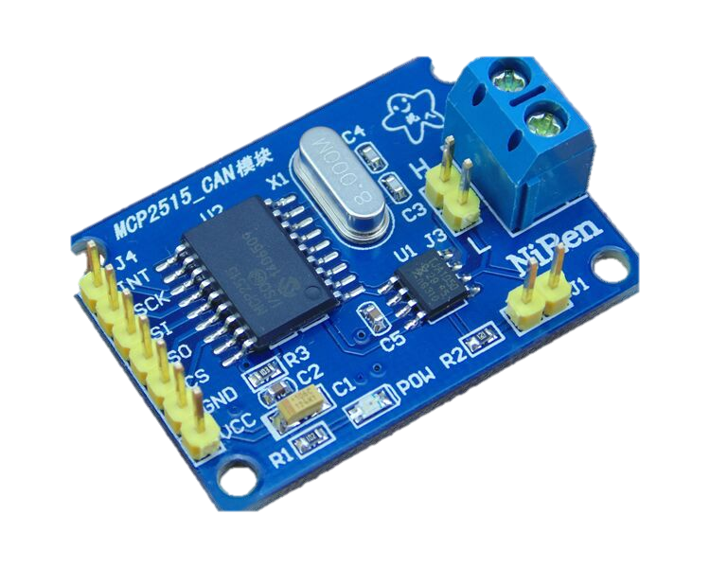

Controller Area Network Block Diagram
Nucleo-STM32F401RE
512KB flash
96KB SRAM
Nucleo-STM32F401RE
512KB flash
96KB SRAM
Node
Receiver
Node
Programmer
SPI
SPI
SDIO
SPI
SPI
CAN
CAN
Slide 4 of N

Slide 6
MCP2515 CAN Bus module
Receives Binary signals
from MCU and converts them into differential CAN signals and vice-versa.
CAN
SPI
SPI
Power machine like x86/x86-64/ARM running Linux.
Performs the AES256-CBC encryption and HMAC calculations.
Flashes it onto SD card using ‘dd’ utility.
Nucleo-STM32F401RE
512KB flash
96KB SRAM
Nucleo-STM32F401RE
512KB flash
96KB SRAM
SPI
Node
Node
Receiver
Programmer
SDIO
SPI
Receiver node, typically
STM32F401 microcontroller executing CAN-J1939 protocol stack, security algorithms and flash update routines.
Secured firmware will be stored into this SD card and then any required algorithms will be executed on it.
Programmer node, typically STM32F401 microcontroller executing CAN-J1939
Protocol stack.
Reads secured firmware from SD card.
Stores the secured firmware generated by power machine.

Slide 7

SD card flashing with secured firmware :
SD card can be flashed easily with secured firmware using ‘dd’ utility which is available on Linux.
But flashing the firmware is not enough alone, we‘ve to explicitly tell the programmer node about the size of the firmware, this can be done by storing the firmware size in initial 4 bytes of the last sector of the firmware, following steps can be executed to make SD card ready for deployment.
A C program can be used for this purpose which just need the firmware file, it will calculate its size, then write it to a .bin file and then execute the ‘dd’ utility to write to the SD card, Completion of this program means the SD card can be used for firmware updates.
‘dd’ utility syntax :
dd if=input_file of=/dev/sdX bs=512 seek=sector_number count=1

Slide 8
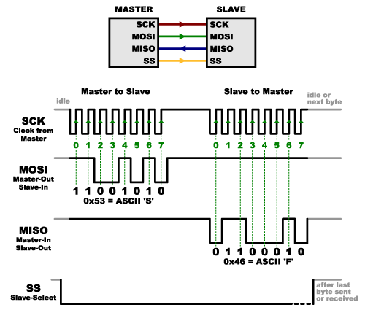
SPI (Serial Peripheral Interface) protocol :
SPI protocol is used intensively in our implementation, SPI serves as interconnect between MCU and CAN bus module, MCU and SD card.
Before using the SPI protocol, underlying SPI hardware must be configured. In our implementation, MCU acts as master thus provides clock for the communication and MCP2515 CAN bus module acts as slave.
Since SPI is full duplex communication protocol, thus as master clock
pulses, both master and slave shifts out data on SPI bus bit by bit in
synchronization with clock pulses, this leads to exchange of dummy
bytes even during transfer of useful data, thus the high-level software (HAL in conjugation with firmware) must handle and parse the received bytes to filter off relevant data and discard the dummy bytes, this software implementation totally depends on slave device architecture like how it accepts commands, arguments and sends out requested data.
SPI protocol itself doesn’t handle data parsing and filtering.
SPI : Data-link layer
protocol / L2 protocol
We don’t need to worry about SDIO protocol since neither we’re implementing it nor we’re using this in core communication, Linux will take care of that.

Slide 9
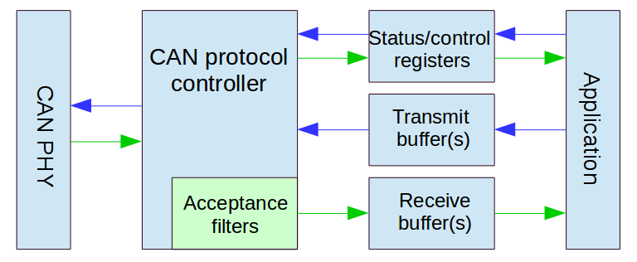
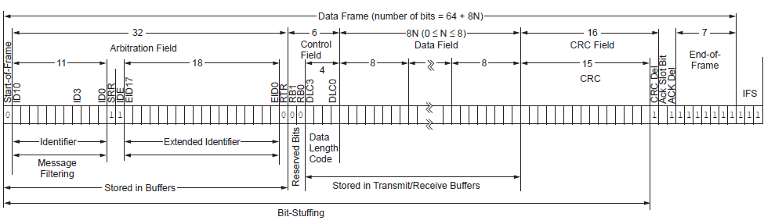
CAN(Controller Area Network) protocol :
CAN has multiple variants like CAN 2.0A, CAN 2.0B, CANopen etc, we’ll be using CAN 2.0B (extended CAN) which has 29 bits identifier field, Its backward compatible with CAN 2.0A as well.
Data-link layer implementation is handled by MCP2515 CAN bus
module which sends out data to other nodes on top of CAN bus
encapsulated in CAN frame, size of this CAN frame depends on choice of CAN variant, for CAN 2.0B, size of each frame excluding
Interframe space is typically 128 bits.
CAN is multi-layered protocol spanning physical and data-link layers.
Extended data frame, SRR and IDE always 1, RTR depends on whether frame contains data (0) or data request (1).
Each CAN frame carries only 8 bytes of data and since we’re using J1939 on top of CAN, thus Data[0] will be used by J1939 Transport layer for frame sequencing, thus only 7 byte of firmware data will be transferred per CAN frame, since only 1 byte is used for frame sequencing, thus one J1939 packet can hold max up-to 1785 bytes (7*255).

Slide 10

J1939 Protocol :
J1939 is core industrial protocol used in large machineries and automotive vehicles. J1939 uses CAN as its physical layer protocol to ensure communication, the application layer of this maps the data and ID into a buffer which is then passed to the transport layer which in turn write the relevant data of CAN frame like 29 bits ID, 8 bytes data, IDE and RTR bits and then sets transmission request bit in ‘TXRTSCTRL’ register using MCP2515 drivers.
Application layer is responsible for handling type of data being sent (PGN), Receiver/Transmitter node address, node address management using networking layer, decision making for transport layer handler type (broadcast/P2P).
Transport layer is skipped if the size of data to be sent is 8 bytes or less, in this scenario, application layer will directly call MCP2515 drivers to transport the data.
J1939 is multi-layered protocol spanning Application layer and transport layer, though spans some part of Networking layer as well via node addressing.
Transport layer handlers are of two types, BAM (Broadcast Announcement Message) and CMDT (Connection Mode Data transfer). As per our deliverables, we need to implement CMDT for node-to-node file transfer.
J1939 protocol stack block diagram is given on next slide.

Slide 11
CMDT (Connection Mode Data Transfer) :

Slide 12
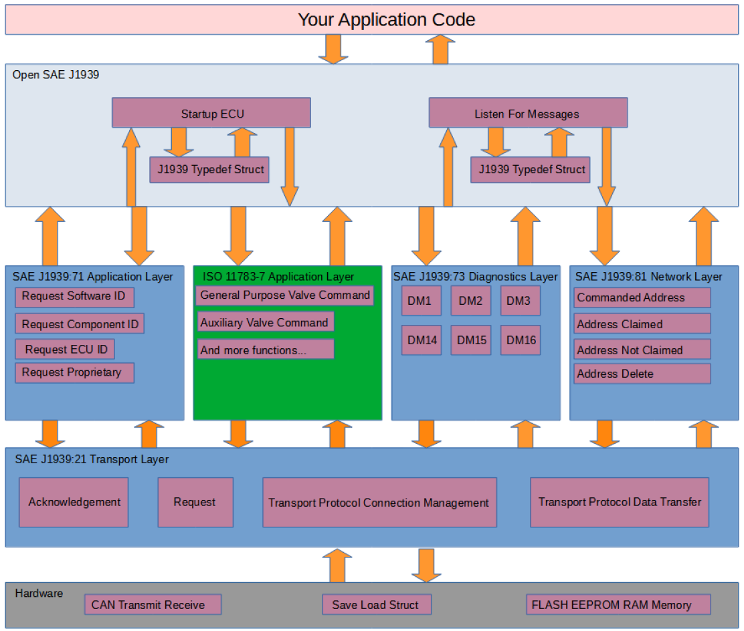

Slide 13
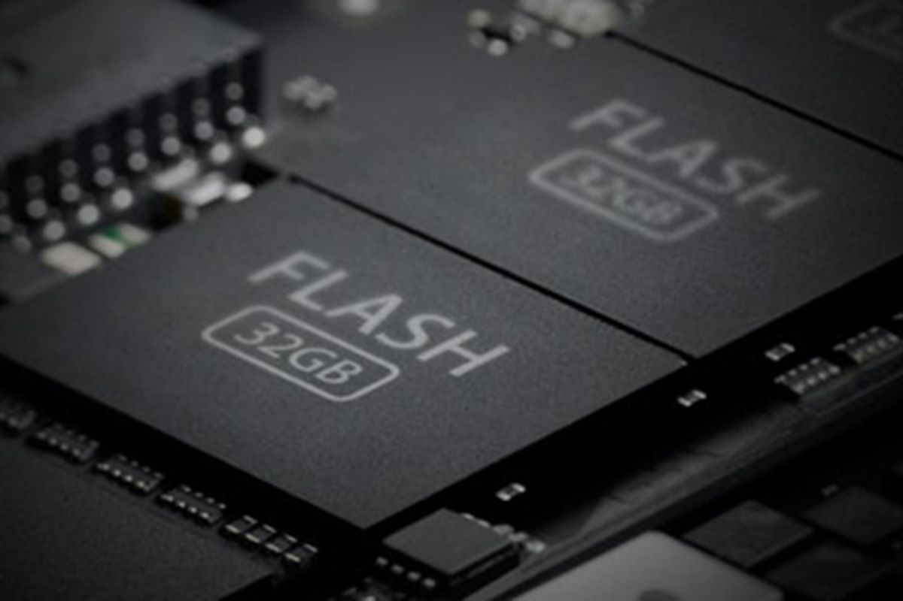
Usage of peripherals, design and implementation depends on the choice of firmware design for both “Programmer” and “Receiver” node.
Let’s discuss how the firmware is designed on both nodes ensuring flawless communication and firmware updates.
Programmer node firmware design and memory layout :
System initialization, peripheral initialization, CAN-J1939 communication routines.
(.text section)
Program data
(.data section)
(load region)
Contains system and user data
I V T
Read only data
(.rodata section)
This firmware design is fixed until some more functionalities are not needed to be added, only secured firmware will change depending on the functionality need to be updated on receiver node.
Flash layout and .bin file structure
0x0800-0000
0x0807-FFFF
512 KBs
The secured firmware will be sent in chunks of 1785 bytes by reading it from SD card to SRAM and then will be sent over CAN-J1939 Protocol to the receiver node, this ensures sufficient processing time for receiver node to process the data and re-assemble it into SD card.
Block size of 1785 bytes is chosen to tackle the problem with J1939 CMDT transport layer handler, it provides only 1 byte to frame sequencing, thus any block size larger than 1785 will cause an overflow situation.

Slide 14
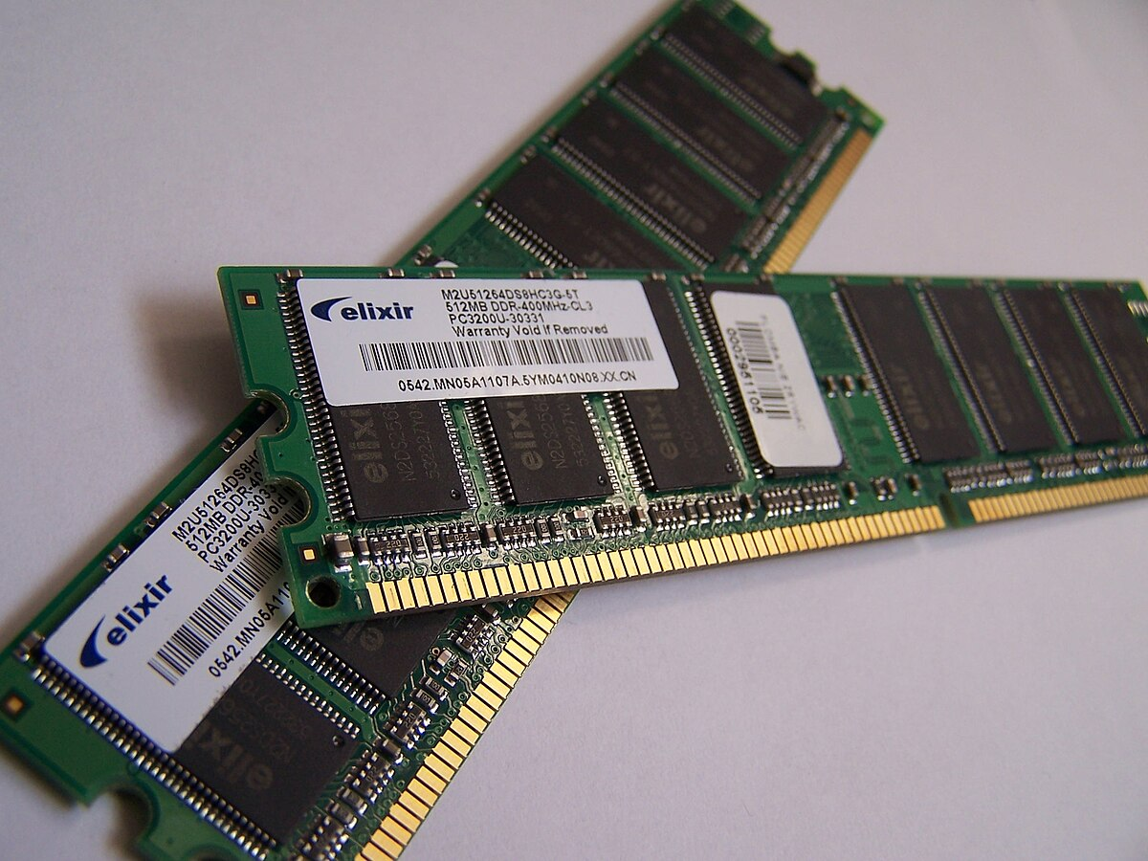
Program data
(.data section)
(modification region, copied from flash)
Program Stack
(typically grows downward.)
Uninitialized data (.bss)
0x2000-0000
0x2001-7FFF
96 KBs
A time domain chart for initial communication and other processing is given on next slide.

Slide 15
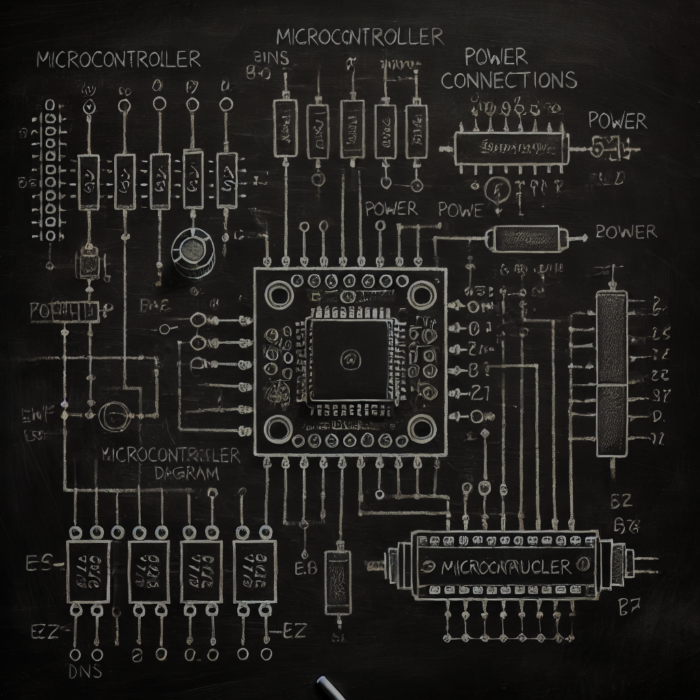

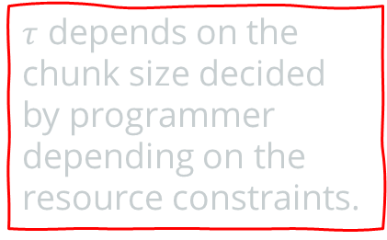

Communication begin
CAN-J1939 communication initialization
Secured firmware transfer in chunks (1785 B)
Programmer MCU
Receiver MCU
Processing period, no data transfer
Secured firmware transfer in chunks (1785 B)
$$τ$$
Processing period, no data transfer
Time
Cycle continues till entire firmware transfer
$τ$ depends on the chunk size decided by programmer depending on the resource constraints.
Communication end
This time–domain diagram represents ideal communication scenarios ignoring real-world problems like power failures or unpredictable system resets.
Such scenarios are handled for communication state recovery by triggering a query to the receiver node which in turn responds with its communication state information.

Slide 16
More details of programmer firmware.
System initialization, peripheral initialization, CAN-J1939 communication routines.
(.text section)
Program data
(.data section)
(load region)
Contains system and user data
I V T
Read only data
(.rodata section)
0x0800-0000
0x0807-FFFF
Typical ISR routine addresses like NMI, hard fault, EXTI for MCP2515 etc.
Program data like J1939 structures, CAN structures and others which will be copied to SRAM during system initialization by startup code.
System clock Initialization at 16MHz, SPI1 initialization at 8MHz (for MCP2515), SPI2 initialization at ‘X’MHz (for SD card).
Read only data like constant addresses for memory and register access.

Slide 17
Exclusive properties of programmer node firmware :
Auto communication state recovery on receiver’s instruction offering resumed and robust communication across power failures and system resets. This is done during CAN-J1939 initialization with a firmware transfer query using extended remote frame, triggered by programming node, receiver node will respond with command instructing fresh or resumed firmware transfer.
Strict usage of static memory allocation avoiding run-time memory allocation and fragmentation issues, ensuring compatibility with industrial standards like MISRA C.
Avoids unnecessary resource usage on programmer node by doing security algorithm computation on PC, this allows the programmer node to be chosen with limited resources that can handle CAN-J1939 protocol stack only.
block0
Programmer’s communication state recovery query
If
command
block1
While(1)
get_block()
block2
block3
Receiver’s command
!command
block(N-2)
block(N-1)
Communication state recovery
block(N)

Slide 18
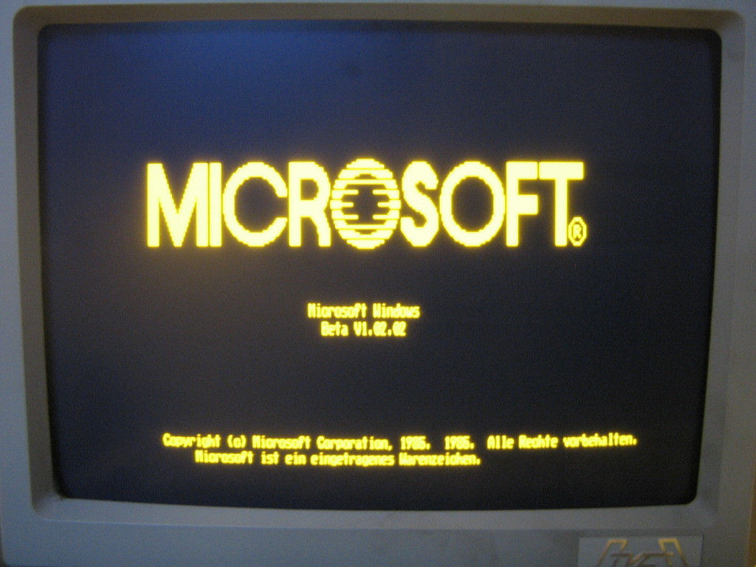
Programmer node boot-up and program flow :
Direct booting from flash memory by boot pins configuration on MCU.
Low level hardware initialization by Reset handler.
Jumping to main firmware for firmware transfer.
Communication state recovery information exchange between programmer and receiver nodes.
Programmer nodes enters low power state after ‘disconnecting peripherals from supply’/’ firmware transfer’.

Slide 19
Receiver node firmware design and memory layout :
Creating a usable Receiver MCU :
All ECUs to be used in industrial machineries/automatic vehicles must be first flashed with a special firmware called “Custom Bootloader” which offers robust and reliable firmware update state recovery across power failures and system resets.
All security algorithms and update routines are implemented in this custom bootloader.
Let’s look at the memory layout of this custom bootloader.
Program data
(.data section)
(load region)
Contains system and user data
IVT : basic ISRs like NMI, hard faults etc.
.text : contains routines for security applications (AES and HMAC) and update routines.
.rodata : contains security algorithm data like KEY/IV/S boxes/Constant matrices.
.data : contains modifiable data for bootloader like subsequent IVs.
System initialization, SPI initialization, firmware update, pseudo File System routines.
(.text section)
I V T
Read only data
(.rodata section)
0x0800-0000
0x0807-FFFF
512 KBs
SRAM layout for this custom bootloader will be similar to that of programmer node since SRAM generally contains stack, .data and .bss and its enough for our implementation.

Slide 20
Exclusive properties of receiver node custom bootloader :
Handles the firmware security execution and updates avoiding repetitive inclusion in new firmware on each update, independent of the underlying communication mechanism for firmware transfer, thus can be used with other physical layer protocols.
Auto-recovery of firmware update state offering robust and resumed firmware update including both security execution and flashing. This is done via a system reset by the receiver node on firmware transfer completion (now the firmware is in receiver’s SD card), on reset, bootloader checks for pending system updates by reading a sector of SD card which store system state information for firmware updates, thus offering reference for the new firmware development which must be strictly followed.
Binds SPI communication routines into it, thus receiver firmware can directly use the addresses of those routines to communicate over any SPI channel.
Strict usage of static memory allocation avoiding run-time memory allocation and fragmentation issues, ensuring compatibility with industrial standards like MISRA C.
Pseudo file system implementation for SD card offering high level APIs to interact with SD card, receiver node firmware must use these APIs via function pointers to interact with SD card, though low-level access is not allowed for security concerns. This API allows limited access to the SD card like access to the firmware read and write, setting system update byte in SD card etc preventing accidental writes to critical sectors. Bootloader specific fields are encrypted (light weight encryption) offering resistance against low level access of SD card via SPI drivers and bootloader specific pFS API routines are password protected to prevent intentional and accidental access to these routine preventing critical data corruption.
Configures the system into a knows state like configuring system clock etc which need not to be done by firmware again unless explicitly needed.
pFS APIs are designed in a way that the firmware region can be used to store some other large data via the same routine(must be done with caution)

Slide 21
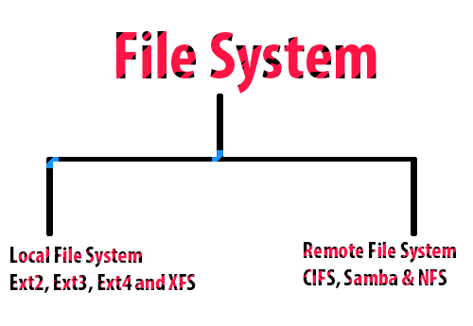
Data organization and pseudo file system
implementation on receiver’s SD card :
SD card on receiver node stores critical information without which the entire implementations seems to be uncompleted. Along with the received firmware, it stores critical system state recovery information for both communication and update processes.
All the information and firmware which is stored in receiver’s SD card
Is stored in an organized way.
This FS contains only 3 sections for now (can be extended in future),
Sector 0 : keeps update state recovery information.
Sector 1 : keeps communication state recovery information.
Sector 2-N : received firmware.
This FS offers an API which the firmware can use to access the SD card in a systematic and secure manner.
Sector 1 is used to store general communication state recovery information, not just for CAN-J1939 protocol, though the idea is to use this sector for communication state information for firmware transfer only but can be extended to general use.

Slide 22
0x00…0
SD card Sector size : 512 Bytes
0xFF…F
Sector 0
Sector1
Secured firmware with IV and HMAC code.
Sector 2 – Sector N
0x0000
Byte 0
Byte to be filled by firmware before reset for bootloader to execute security and update routines.
(uint8_t)
Byte 1-4
Byte 5-8
Contains critical information for system state recovery during firmware update.
Byte 9-24
Bytes used by bootloader itself
for storing the security progress/check-points. (uint32_t)
Bytes used by bootloader itself
for storing the firmware update progress/check-points.
(uint32_t)
Not accessible to firmware via API in sector
Reserved for future
Accessible to firmware via API in sector
AES256-CBC IV
(uint8_t*)
0x01FF
For future expansions like AES/HMAC key overriding etc.
(uint8_t*)

Slide 23
0x00…0
SD card Sector size : 512 Bytes
0xFF…F
Sector 0
Sector1
Secured firmware with IV and HMAC code.
Sector 2 – Sector N
0x0200
Bytes used by firmware to store the communication state like 1785B block count. (uint32_t)
CAN frame counts. (uint32_t)
Contains critical information for system state recovery during firmware transfer communication.
Byte 12-15
Entire Firmware size received at beginning. (uint32_t)
Byte 0-3
Byte 8-11
Byte 4-7
Firmware size during communication. (uint32_t)
Not accessible to firmware via API in sector
125* 32 bits chunks
Accessible to firmware via API in sector
124*32 bits chunks for extended usage of FS to store general information. (uint32_t)
0x03FF

Slide 24
More about custom bootloader :
typedef struct {
void (*SetUpdate)(void)=SetUpdateByte;
void (*SetBlkCnt)(uint32_t)=SetBlockCount;
uint32_t (*GetBlkCnt)(void)=GetBlockCount;
void (*SetFWRSize)(uint32_t)=SetFirmwareSize;
uint32_t (*GetFWRSize)(void)=GetFirmwareSize;
void (*SetFWRSize_OC)(uint32_t)=SetFirmwareSize_OC;
uint32_t (*GetFWRSize_OC)(void)=GetFirmwareSize_OC;
void (*WriteFWRSTR)(uint8_t*, uint32_t)=WriteFWRSector;
void (*ReadFWRSTR)(uint8_t*, uint32_t)=ReadFWRSector;
void (*SetWD)(uint8_t, uint32_t)=SetWord;
uint32_t (*GetWD)(uint8_t)=GetWord;
} pFS_ops ;
Placed in “pFS” section for being used by firmware
Placed in “Spi” section for being used by firmware
Program data
(.data section)
(load region)
Contains system and user data
System initialization, SPI initialization, firmware update, pseudo File System routines.
(.text section)
Read only data
(.rodata section)
I V T
// FS API collection.
// part 1
void SetUpdateByte(void){}
void SetBlockCount(uint32_t blk_id){}
uint32_t GetBlockCount(void){}
void SetFirmwareSize(uint32_t){}
uint32_t GetFirmwareSize(void){}
void SetFirmwareSize_OC(uint32_t){}
uint32_t GetFirmwareSize_OC(void){}
void WriteFWRSector(uint8_t* addr, uint32_t sector){}
void ReadFWRSector(uint8_t* addr, uint32_t sector){}
void SetWord(uint8_t chk_id, uint32_t val){}
uint32_t GetWord(uint8_t chk_id){}
// part 2
void ClearUpdateByte(uint32_t psd){}
void SetSecState(uint32_t sec_state, uint32_t psd){}
uint32_t GetSecState(uint32_t psd){}
void SetUpdateState(uint32_t upd_state, uint32_t psd){}
uint32_t GetUpdateState(uint32_t psd){}
void GetIV(uint8_t* IV, uint32_t psd){}
Void SetIV(uint8_t* IV, uint32_t psd){}
typedef struct {
/**
* appropriate pointers to
* SPI routines.
*/
} SPI_ops ;
0x0800-0000
0x0807-FFFF
512 KBs
// SPI routines collection
Part 2 routines of FS API are password protected thus can be used by bootloader only, on top of that, bootloader critical fields are encrypted with some key, thus even raw access to SD card won’t work as expected.

Slide 25
Bootloader execution with power failure persistence and control transfer to firmware :
Power on
Clearing byte 0 of sector 0
System reset
Initializes system with clock and SPI1 configuration
Resuming firmware update
Clearing byte 0 of sector 0
Reading Byte 0 of sector 0
Firmware update state recovery
Starting fresh firmware update
HMAC integrity verification
Power failure
Jumping to firmware
firmware
AES256-CBC decryption

Slide 26
Firmware update process after reset :
Design choice for flashing routine depends on the firmware file format which is being used to transfer the firmware, currently we’ve two choices, using .hex format or .bin format
Firmware file format
.hex format :
In this scenario, the custom bootloader will be similar to manufacturer’s bootloader since it need to parse the records of .hex file to write to flash memory, this way the bootloader can either parse the entire file first then write to flash(not good idea, resource intensive) or It can on hand parse each record and write to flash.
.bin format :
In this scenario, the routine just need to copy the data as it is from SD card to flash at <> address since the firmware received is basically in memory map format thus just copying to flash works fine, but the size of .bin file may be large in case some firmware data resides at very high addresses, thus all unnecessary intermediate bytes (which are of no use to firmware) will also be flashed causing unwanted resource consumption.
We’ll be using .bin format for firmware transfer for now.

Slide 27

Bootloader’s transition to firmware :
During transitions, both program does something specific on their own side.
Bootloader disables IRQs for avoiding overhead.
Bootloader will relocate the IVT via accessing NVIC and setting the pointer to firmware’s IVT for more complex and peripheral interrupt handling.
Bootloader will then set the stack pointer for firmware and then jump to the reset vector of the firmware.
Firmware on its side during initialization will erase the entire SRAM for security measures via an assembly routine bypassing stack-based routine calling convention as done in C to avoid overwriting stack data during SRAM erasure.
Firmware will call main() and pass control to it where it will enable interrupts depending on its requirements.
Transition ahead
Linker script for receiver firmware must be carefully modified so that the .hex file contains address relative to <>, not 0x0800-0000.
Receiver’s firmware share similarities with programmer node’s firmware in context of application specific routines, ISRs etc. Initialization routines like clock configuration, SPI 1 initialization etc are handled by the custom bootloader, though resides at some higher address <> instead of 0x0800-0000.

Slide 28
Exclusive properties of receiver node firmware :
Very light weight and application specific only like communicating with peripherals and doing computation. No need to take care of security and update routines each time reducing firmware size, transfer and update time.
Written on top of reference provided by the custom bootloader achieving efficient resource management by avoiding repetitive inclusion of pseudo file system API routines, SPI routines etc.
Strict usage of static memory allocation avoiding run-time memory allocation and fragmentation issues, ensuring compatibility with industrial standards like MISRA C.
Auto communication state recovery by storing number of received blocks(each of 1KB/2KB) into SD card after copying the block to SD card from SRAM via the pseudo file system API included in reference provided by custom bootloader, this critical information is sent to programmer node in response to communication state recovery query .
Bootloader will use the entire SRAM for its own purpose like for stack and program data (.data/.bss) which will be cleared by firmware during its initialization(.init etc), thus the firmware must be designed with this capability of SRAM erasure to ensure no sensitive information of bootloader gets exposed to firmware which may include AES/HMAC/bootloader field keys etc.

Slide 29
Receiver node firmware execution :
First step of firmware execution after getting processor control is to check whether any communication was pending or not by looking at byte 0-3 (uint32_t) of sector 1, depending on which it responds to communication state recovery query raised by the programmer node. If communication is pending, it will wait for programmer’s query for communication state recovery, else it will continue with its normal operations, it may receive a query from programmer node during its normal operations if byte 0-3 are not marked (this indicates that programmer node is now involved in CAN communication and wants to update it).
Communication will either start from a resumed state or a fresh state, the entire firmware data received during this communication is stored directly into the firmware region of SD card.
Once the entire firmware has been received, byte 0 of sector 0 is marked using SetUpdate() of pFS API followed by system reset which on next reboot informs custom bootloader to start firmware update. Note that this routine must be used in the firmware data reception handler build on top of J1939 protocol as incorrect usage may trigger an unwanted system update which may lead to data and firmware corruption if not handled properly.

Slide 30
Communication state recovery query and response CAN frame structure :

Slide 31
Communication begin
Reboot on power failure
Normal communication flow
Recovery decision
Communication state recovery
Programmer MCU
Receiver MCU
$$τ$$
Time
Communication failed due to power failure/system reset
Communication end
Power failure handling during communication

Slide 32
Future add-ons :
Adding Key overriding feature to the custom bootloader to ensure usage of new keys for AES256-CBC and HMAC in case of key exposure.
Using .sb file (a new type of file developed by team SockBurst) instead of .bin/.hex for firmware transfer, the .hex file will be converted into .sb file resulting in size reduction of firmware

Slide 33
References :

Slide 34
Contd…

Slide 35
System state recovery is triggered by the receiver node, it will inform the programmer node about its state before power failure, thus programmer node will resume the communication over J1939 accordingly. Programmer node SD card will only store secured firmware written into it by PC.
Receiver node SD card will contain system state recovery information and receiver secured firmware
Usage of SD card on receiver node for handling large sized firmware since avoiding this will result in usage of flash itself for unencrypted firmware which will limit the size of the new firmware by half of the flash size nearly.
Additional functionalities like mosfet controlled supply to peripherals (sd card, can module)
Problems with other approaches ???
Possible questions for live presentation.
Important aspects :
Highly reliable
Offers compatibility with industrial standard and legacy systems.
Vacancies for future modifications and additions.
Custom bootloader reference manual for new firmware development
.sb file for firmware(to be sent) size reduction. If used .hex, bootloader will bloat up, if .bin used, firmware size will bloat up consuming more resources and time.
Addition of security layer on bare access of SD card by firmware via storing the data on SD card after
Light encryption instead of direct storing thus data can only be retrieved by FS APIs only, putting those routines which are not intended for use by firmware as password protected via passing a psd arg.
Entire communication time flow chart including power failures/system resets.
Re-lookups :
Slide 9 for SPI2 baud-rate.
Slide 15 for firmware address.

